Slide 1



Image Classification
Using Scikit-learn

Slide 2
Agenda
01
Importing the Libraries
02
Loading the Data
03
Data Preprocessing
04
Implementing ML Algorithms
05
Hyperparameter Tuning

Slide 3
Problem Statement

Slide 4

Problem Statement
You are a data-scientist of a global company. As a data-scientist you have to build an image classification model to classify 2 categories of images namely cat and dogs.

Slide 5

Dataset Information
Cats and Dogs dataset contains 1000 images out of which 500 images are of cat and same for the dog.

Slide 6
Importing the Libraries

Slide 7
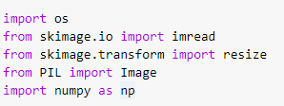
Importing the Libraries
We start off this project by importing all the necessary
libraries that will be required for the process.

Slide 8
Loading the Data

Slide 9
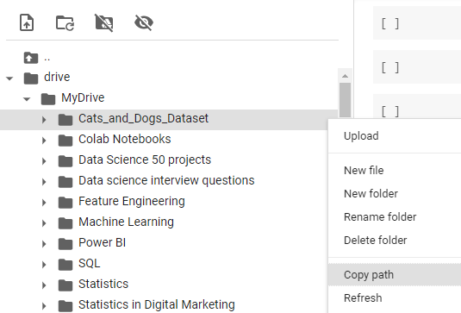
Loading the Image Data
Loading the image data by mounting the drive and providing the path of a folder stored in drive.

Slide 10
Data Preprocessing

Slide 11
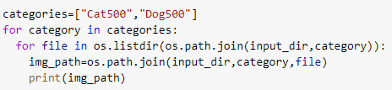
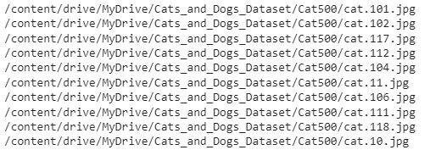
Displaying the Image
To display an image we need a path of each image. Here we are using two functions
to handle path .
os.listdir - print a list of names of all the files
present in the specified path.
os.path.join - return a combined path by
merging arguments.

Slide 12
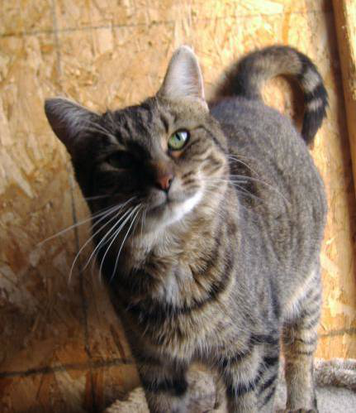
Displaying the Image
Taking any random path of the previous output to display the image.

Slide 13
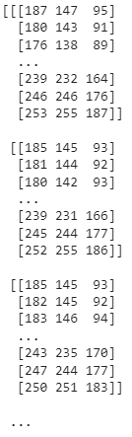

Image conversion to array
Converting the image to numpy array

Slide 14
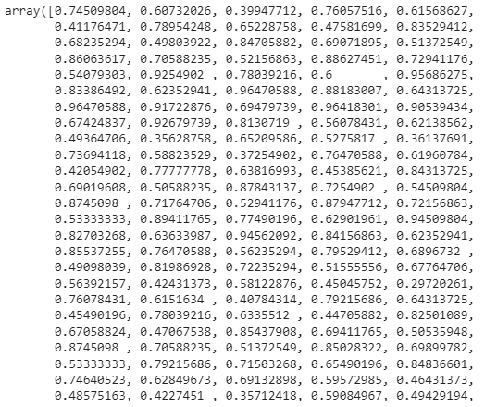


Image conversion to array
Resizing and flattening the numpy array.

Slide 15

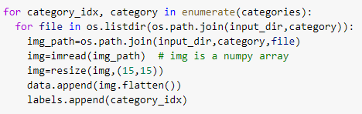

Image conversion to array
Converting all the images into a 1-D array and storing it into data variable. Here Label contains two categories i.e 0 (Cat) and
1 (Dog)

Slide 16
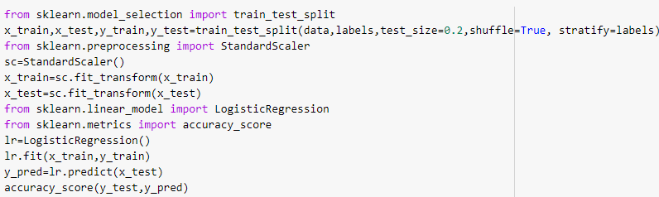

Logistic Regression
Accuracy obtained by logistic regression is 54 percent.

Slide 17
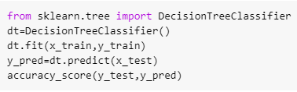
Decision Tree
Accuracy obtained by decision tree model is 56 percent.

Slide 18
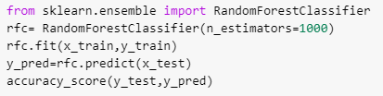
Random Forest
Accuracy obtained by random forest model is 64.5 percent.

Slide 19
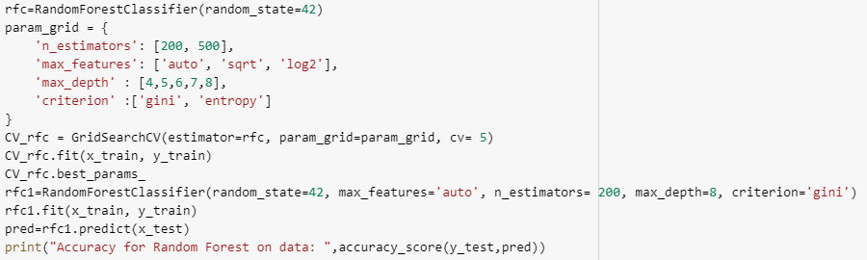
Hyperparameter Tuning - Random Forest
Accuracy obtained by random forest model is 65.5 percent.

Slide 20
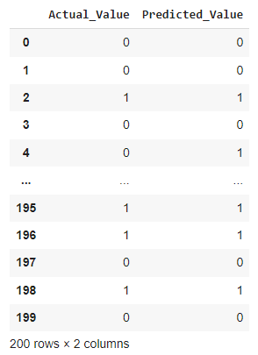
Hyperparameter Tuning - Random Forest
Creating the dataframe for actual and predicted value.
Note - We have trained 1000 images of cats and dogs. Increase in sample image
will lead to increase in accuracy.

